Slide 1

Neural Style Transfer
What is neural style transfer?
deeplearning.ai

Slide 2
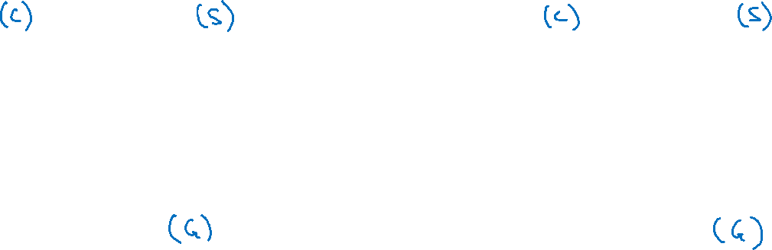
Neural style transfer
Content
Style
Content
Style
Generated image
Generated image
[Images generated by Justin Johnson]

